Slide 1
Azure DevOps Code Quality and Testing
July 30, 2019
Stephen T. Mann
Cloud Solution Architect

Slide 2
Agenda
Automated Testing
Analytics
Custom Templates
Return on Investment
Microsoft’s QA Journey

Slide 3
Microsoft’s QA Journey

Slide 4
QA @ MSFT pre-2000
PMs owned understanding customer requirements and writing feature specs
Devs owned designing and coding the features.
Testers owned testing the features.
Teams had a ratio of 1 dev to 1 test to 0.5 PM, with some variance among teams.
The test discipline had two separate roles: Software Design Engineer Test (SDETs) who developed the automation, the test infrastructure etc., and then Software Test Engineer (STEs) who ran the automation or who ran manual tests.

Slide 5
QA @ MSFT post-2000: Transformation 1
Software Design Engineer Test (SDETs) and Software Test Engineer (STEs) merge.
A companywide decision was made to get rid of the STE roles and make SDETs accountable for not only developing tests but also running and maintaining automation.
This improved the model. It improved accountability and incentive on SDETs to write better and more automation. But the core problem remained. The SDETs couldn’t keep up with the code thrown over the wall.

Slide 6
QA @ MSFT mid-2000: Cloud Cadence
Shifting our quality priorities.
We pushed testing left, we pushed testing right and got rid of most of the testing in the middle. This is a departure from the past where most of the testing that was happening in the middle – integration style testing in the lab.
Shifting QA left = Testing early and often.
Shifting acceptance/user testing right = Production is a test ground.

Slide 7
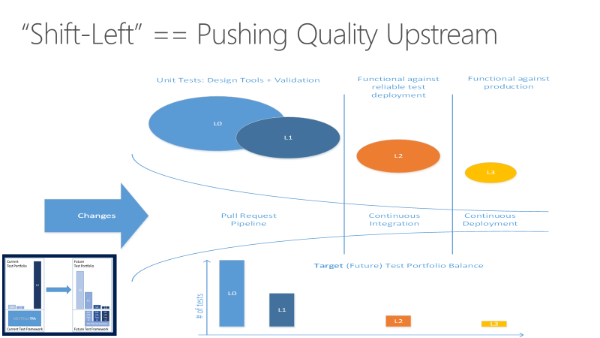
Shifting left with automation

Slide 8
Anatomy of Automated Testing
Test Taxonomy
We needed new taxonomy. Previous taxonomy was based on duration of the tests, nightly run (NAR), full automation run (FAR), etc. We created new taxonomy that was based on the measure of external dependencies. We roughly divided tests into two categories: Unit Test and Functional Tests
L0/L1 – Unit tests
L0 – Broad class of fast in-memory unit tests. An L0 test is a unit test to most people. That is a test that depends on code in the assembly under test and nothing else. <60ms execution.
L1 – A L1 test might require the assembly plus SQL or the file system. ~<400ms execution, not >2s.
L2/L3 – Functional tests
L2 – Functional tests run against “testable” service deployment. It is a functional test category that requires a service deployment but may have key service dependencies stubbed out in some way.
L3 – This is a restricted class of integration tests that run against production. They require a full product deployment.

Slide 9
Automated Testing

Slide 10

What makes a good automated test?
Easy to write
Test should be smaller, simpler
More tests are better than more complex tests
Readable
A tests intent should be clear from a simple glance
Reliable
Should only fail when it is supposed to
Fast!
Many tests add up
Slow tests get tend to be skipped
Truly unit, not integration
Credit: Sergey Kolodiy - https://www.toptal.com/qa/how-to-write-testable-code-and-why-it-matters

Slide 11
Additional Qualities
Requires no human interaction to start or collect results.
Provides a consistent result regardless of changes to external changes.
Should be singularly focused.
Should invoke a small portion of code and observe the result.
Follows the three A’s:
Arrange, Act, Assert
Notes:
Retrieving users from db with/without db connection
No users are returned
User object in loop is/is not admin

Slide 12
Identify all tests – Exercise 1
get all users from User table in DB
for-each user, if user “IsAdmin”
return true
else
return false
Notes:
Retrieving users from db with/without db connection
No users are returned
User object in loop is/is not admin

Slide 13
Identify all tests – Exercise 2
on term search
post term to search service
await search service results
take top 10 results from results
if top10 is 0
redirect to suggestion page
else
return top10

Slide 14
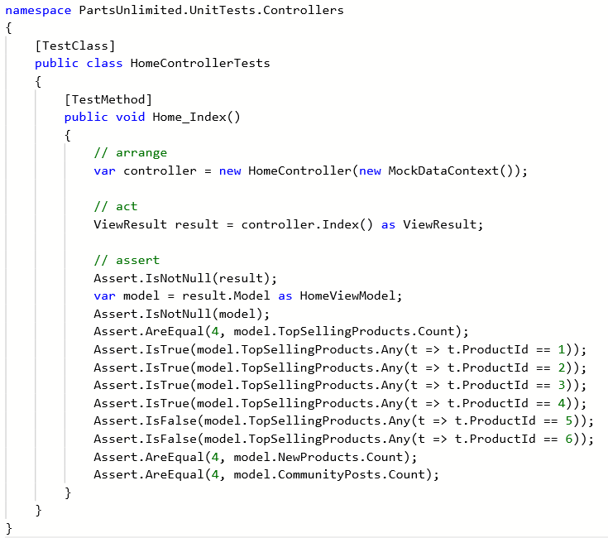
L0 – In Memory Tests
Fully contained
Use mock libraries to simulate data calls
Controlled input values return repeatable, predicable results
Won’t catch problems related to data connections, data corruption/validity, or versioning issues.

Slide 15
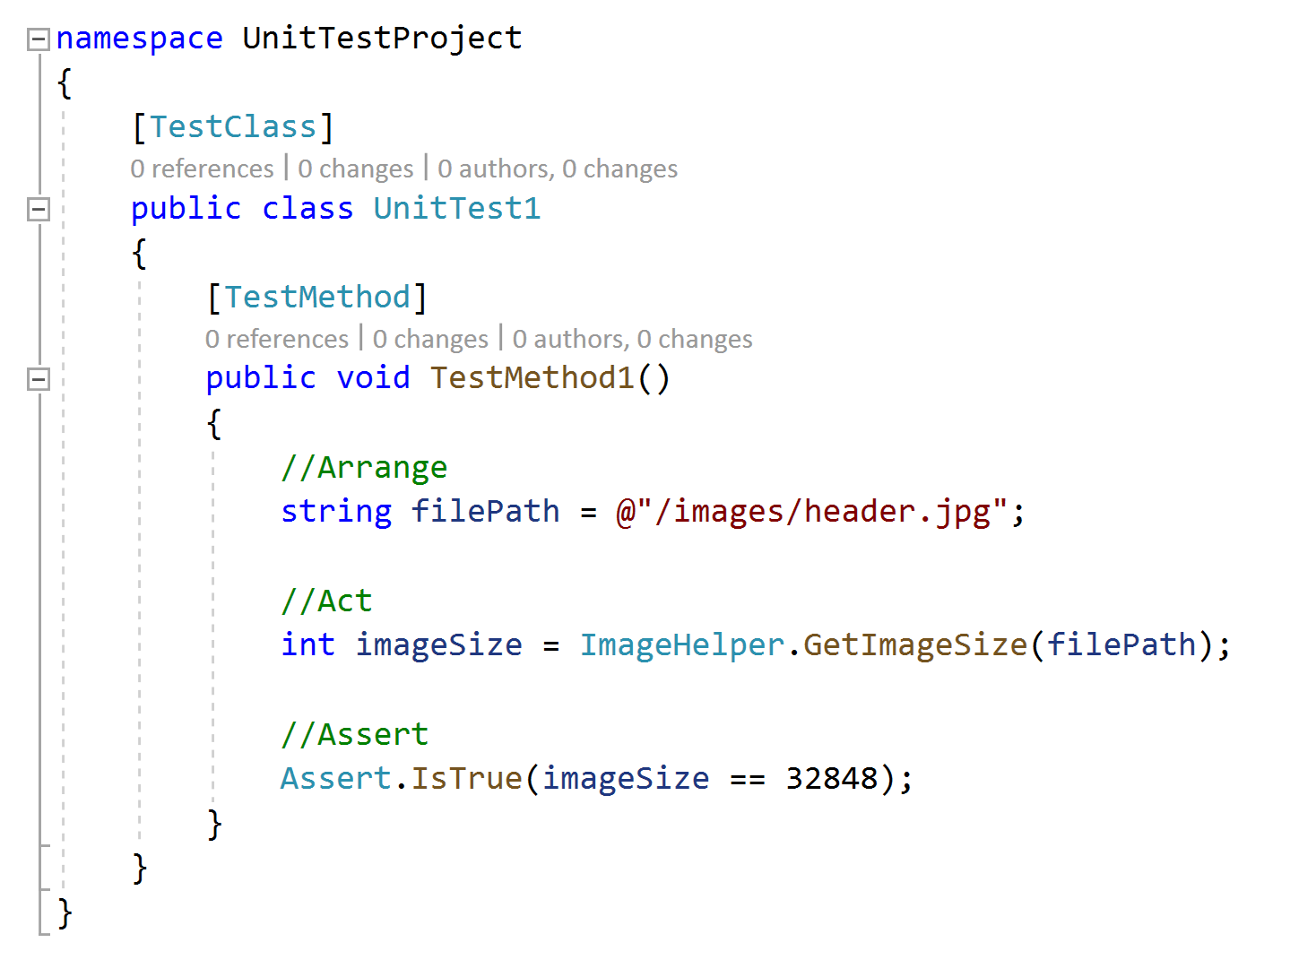
L1 – In Memory Tests w/External Services
Can test against some local resources
May still mock libraries to simulate data calls
External resources introduce variables that may result in flakey tests
Will catch problems related to data connections, data corruption/validity, or versioning issues

Slide 16
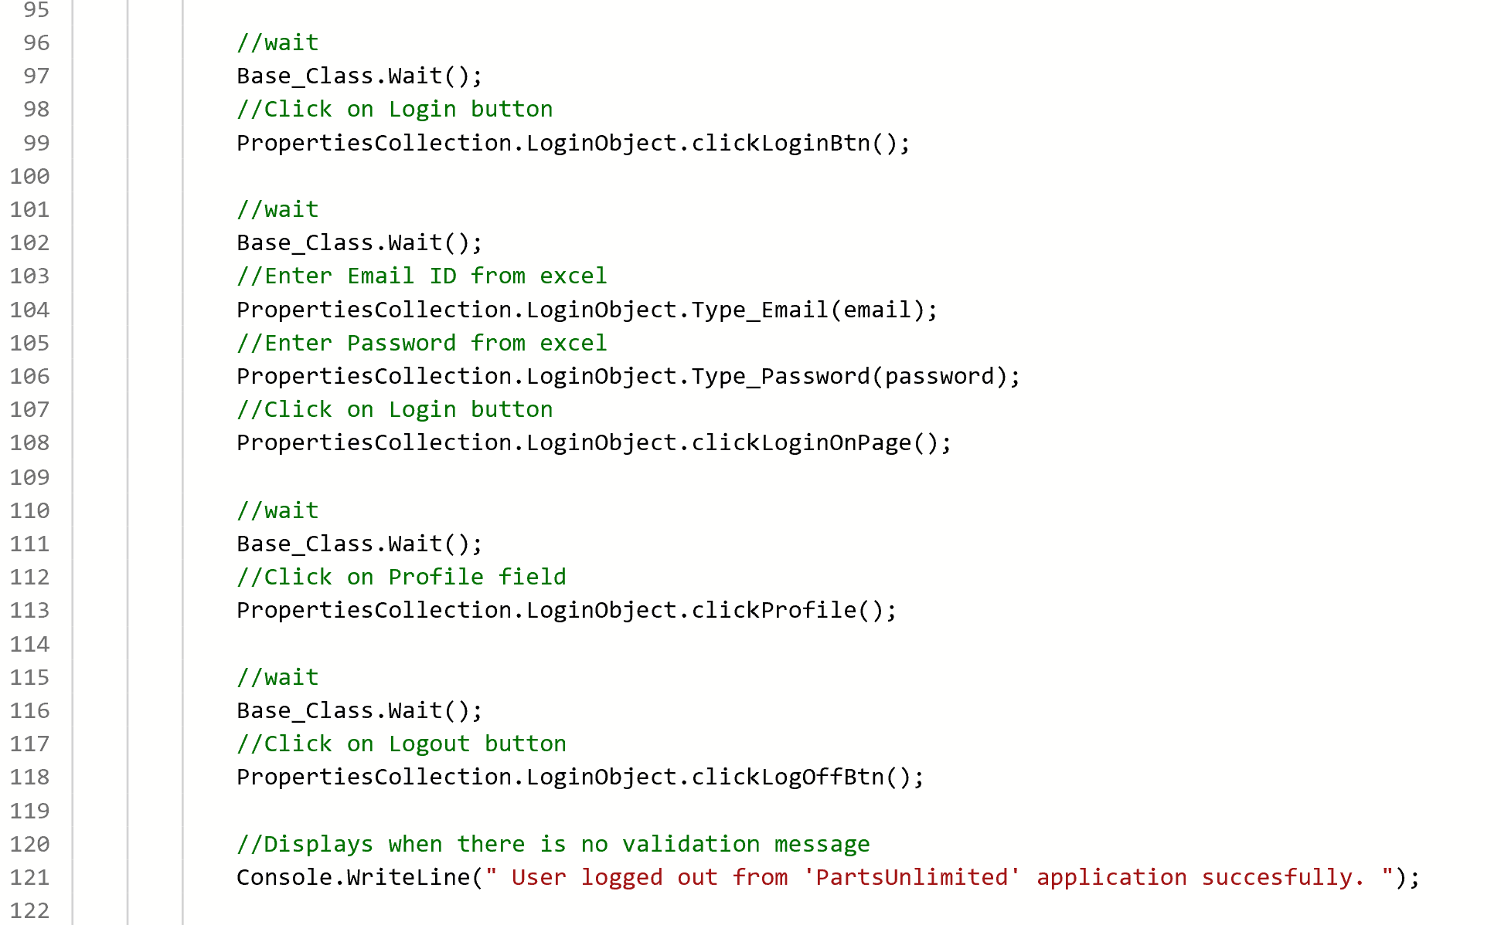
L2/L3 – Functional Testing
Requires deployed resources
Real data, truer to production results
External resources introduce variables that may result in flakey tests
Will catch problems related to data connections, data corruption/validity, or versioning issues

Slide 17
Demo
Test Automation E2E Creation
Notes:
https://www.azuredevopslabs.com/labs/vstsextend/selenium/

Slide 18
Tools

Slide 19
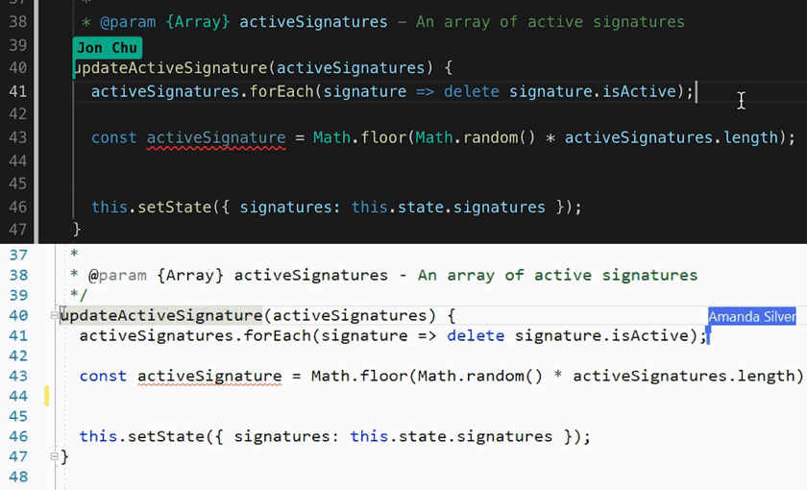
Visual Studio Live Share
Real-time collaboration
Co-editing, co-debugging
Shared servers
Shared terminal
Audio calls
Focus and follow

Slide 20
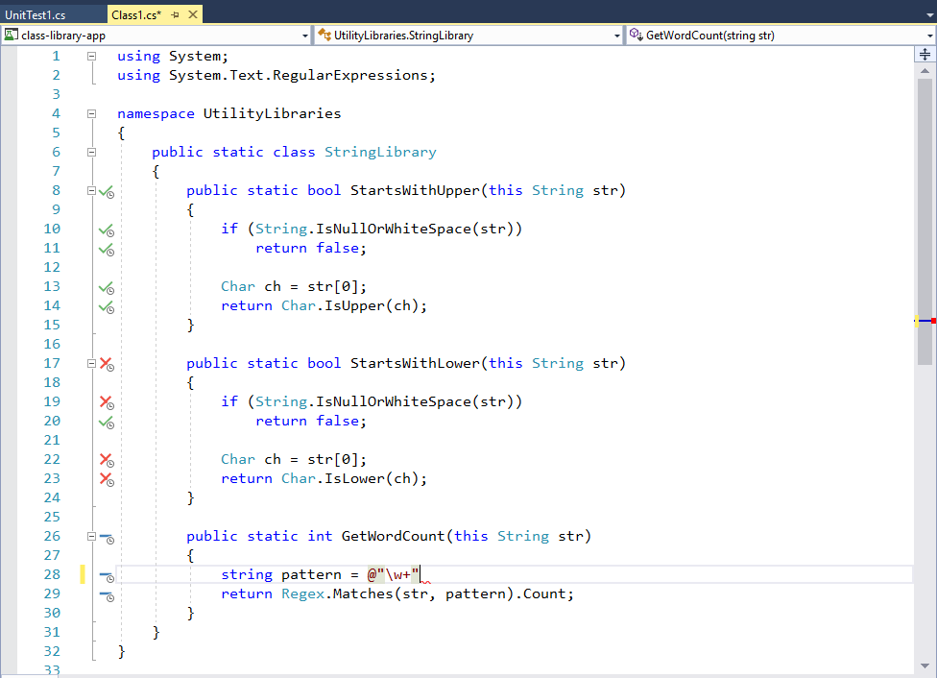
Visual Studio Live Unit Testing
View coverage visualization in the editor as you type.

Slide 21
Analytics

Slide 22
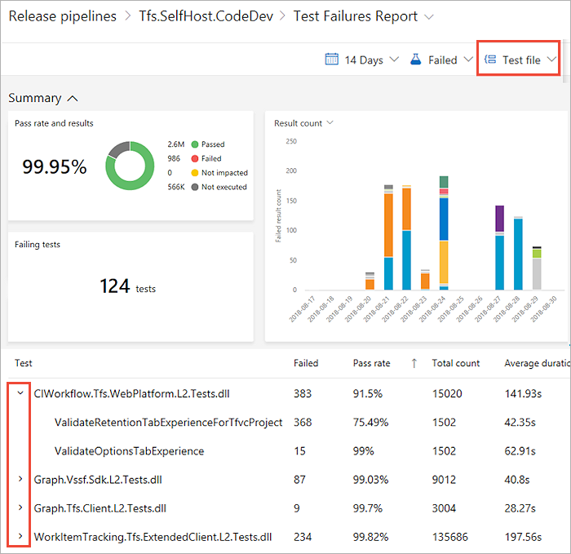
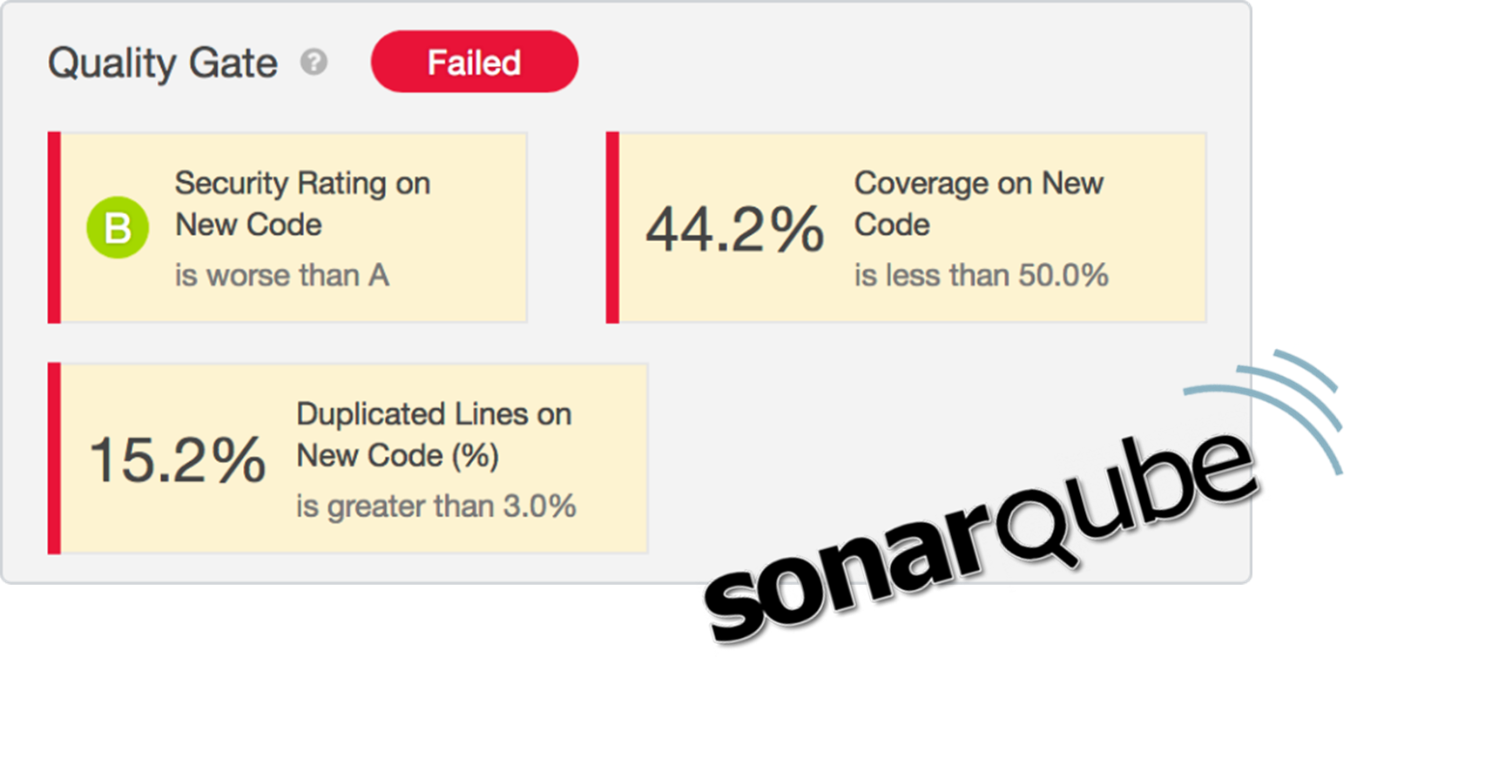
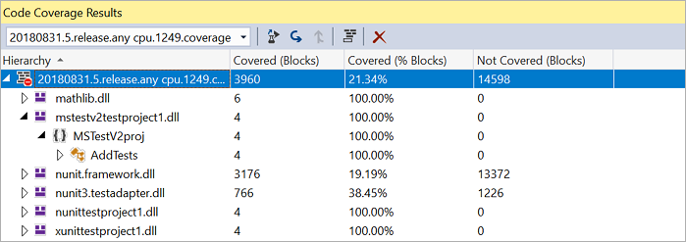
Analyzing test results
Visual Studio
Pipeline Analytics
Third-Party

Slide 23
Demo
Azure DevOps Pipeline Analytics

Slide 24
Return on Investment

Slide 25
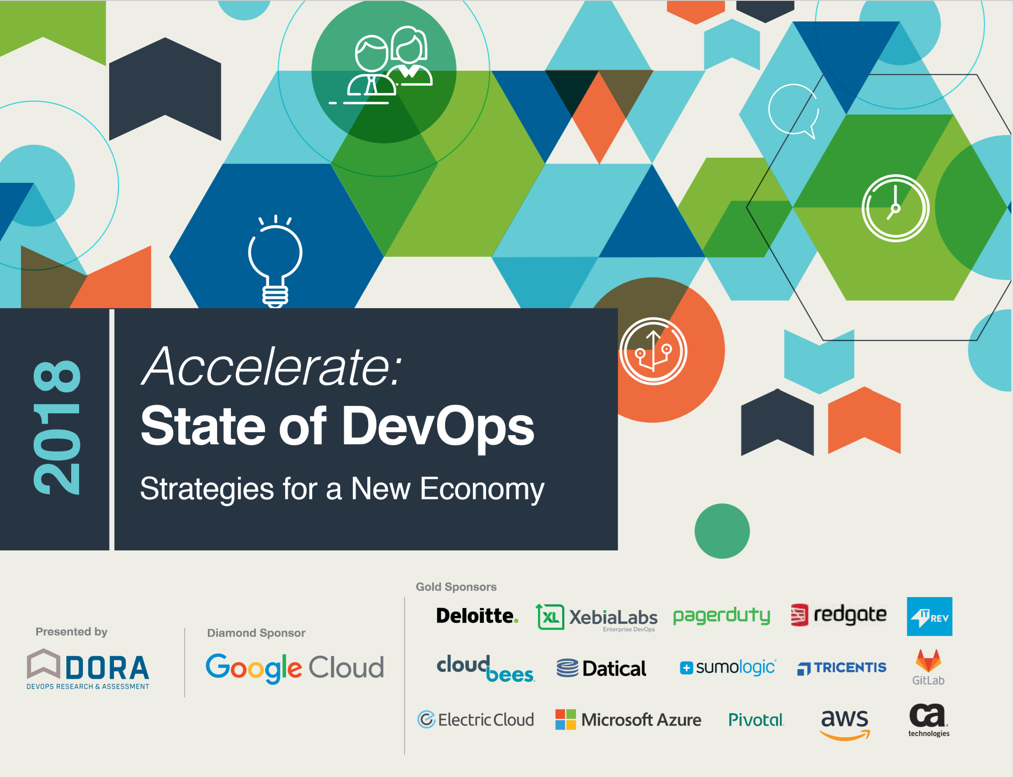
DORA – State of DevOps

Slide 26
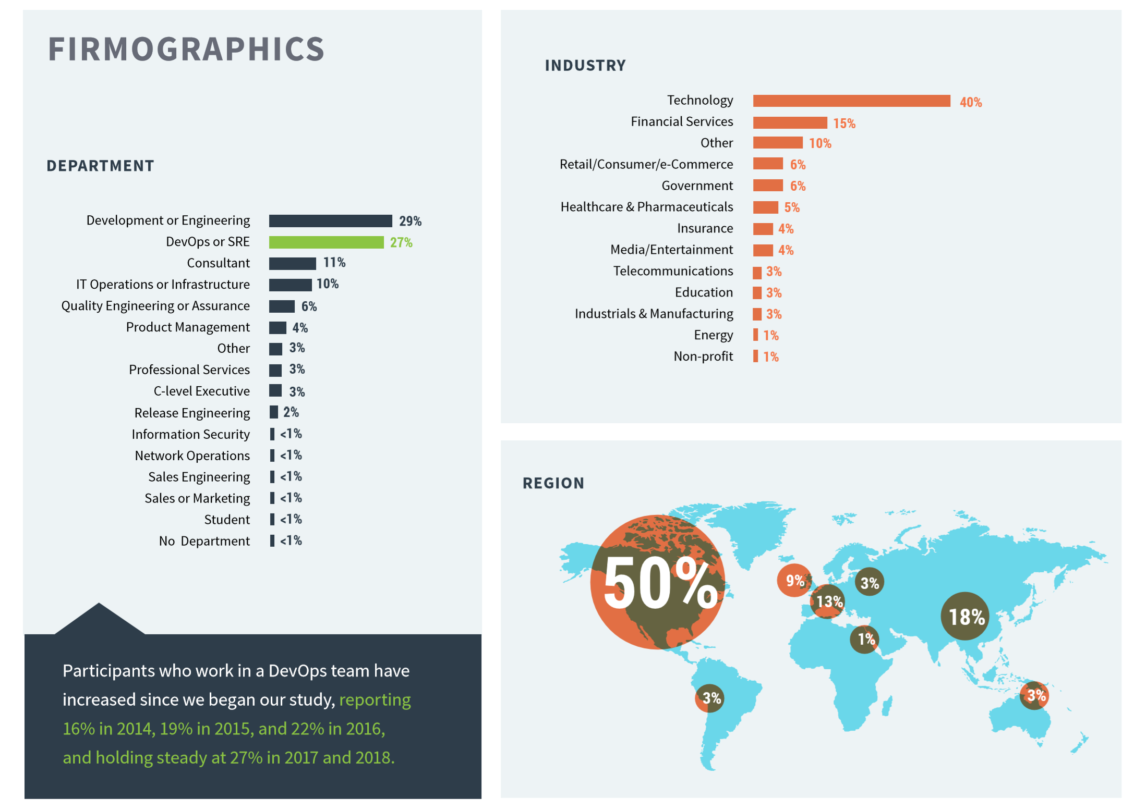
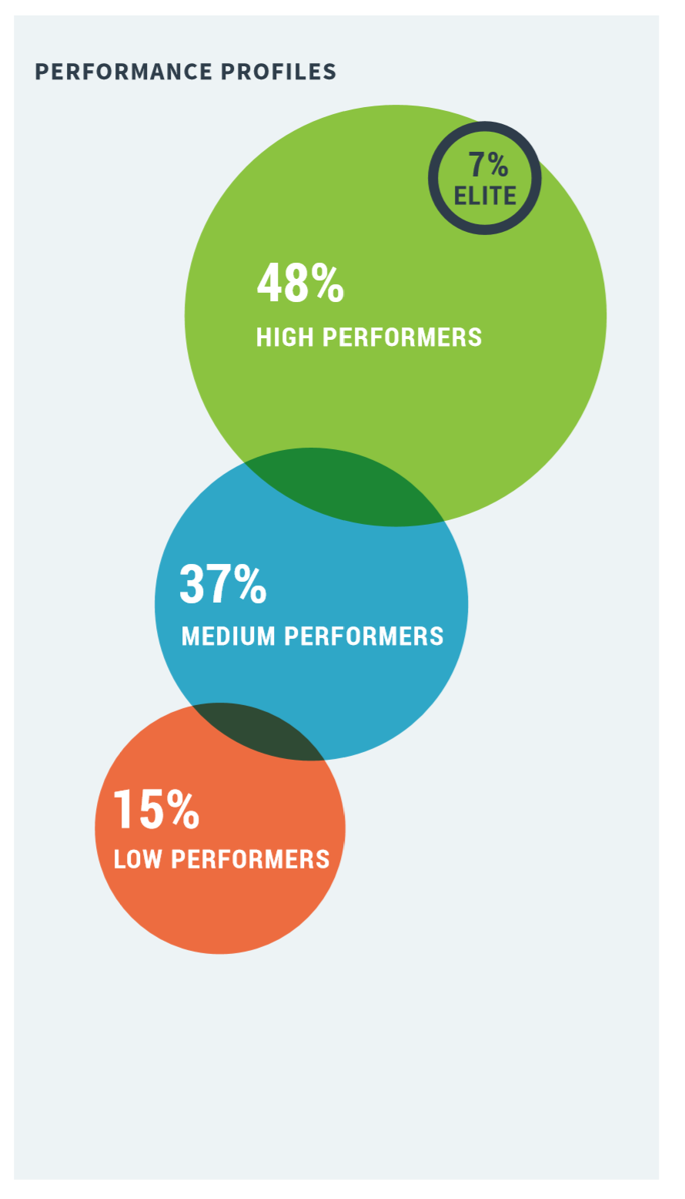
Who’s who?

Slide 27
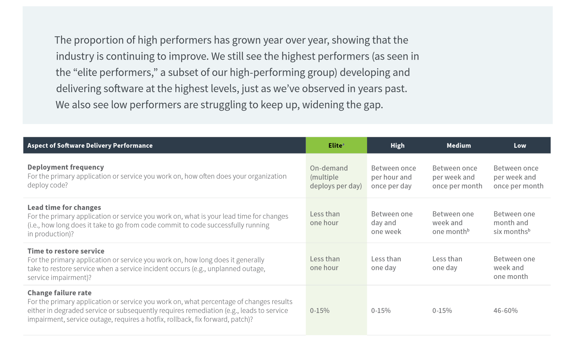
Measuring Performance

Slide 28
QUALITY OUTCOMES
Teams and organizations embarking on technology transformations also have goals of improving quality. However, measuring quality is challenging because it is context-dependent and many measures vary by industry and even by company.¹⁰
Despite the challenges of identifying quality metrics that apply to all organizations, we can identify good proxies for quality that work across companies and industries. These include how time is spent, because it can tell us if we are working on value-add work or non-value-add work. In this research, we used measures such as the proportion of time spent on manual work, unplanned work or rework, security remediations, and customer-support work, and the results were revealing. Our analysis shows that high performers do significantly less manual work across all vectors, spend more time doing new work, and spend less time remediating security issues or defects than their low-performing counterparts. Because they build quality in, they spend less time fixing problems downstream, freeing up more time to do value-add work.
¹⁰ This concept is discussed by software quality expert Jerry Weinberg in his book Quality Software Management. Volume 1: Systems Thinking. New York: Dorset House Publishing, 1992.

Slide 29
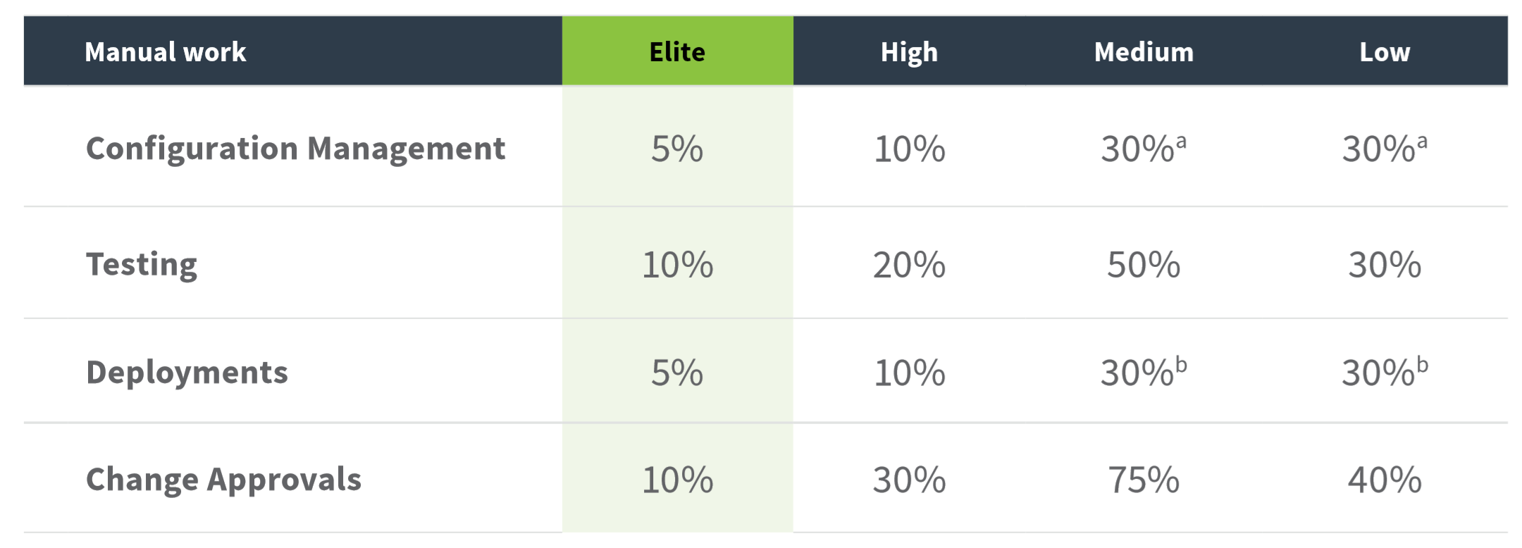
Percentage of Manual Work by Area

Slide 30
Value from testing and quality
In order to understand the investment value of test coverage, we need to answer the three questions:
What is defect detection effectiveness curve for X% coverage?
What is the effort needed to obtain X% coverage?
When is the incremental defect detection cost effective for a particular set of quality requirements?

Slide 31
Was forcing higher coverage worth the cost?
We also found that the test effort increases exponentially with test coverage, but the reduction in field-reported bugs increased only linearly with test coverage. This suggested that for most projects the optimal levels of coverage are likely to be well short of 100%. The main takeaways from this research study are:
Code coverage should not be used alone. It should be used in conjunction with other techniques like static analysis, fault injection, etc.
Code covered is not necessarily correct in its behavior.
It might not be worth the effort to achieve 100% coverage for pre-existing code.

